Slide 1

NODE JS PROJECT
NAME:- SHIVAMNATH
REG. NO. :- 12018682
SECTION:- K20PG

Slide 2

TYPING SPEED TEST WEB APPLICATION
Introduction:
The Typing Speed Test web application is designed to measure the typing speed and
accuracy of users. The application consists of a front-end component, implemented using
HTML, CSS, and JavaScript, and a back-end component implemented using Node.js and
Express. The front-end component provides a user interface for the typing test, while the
back-end component serves static files and handles incoming HTTP requests.

Slide 3

Technologies Used
HTML: A markup language used for creating the structure and content of web pages.
CSS: A styling language used for designing the appearance and layout of web pages.
JavaScript: A scripting language used for adding interactivity and dynamic content to web
pages.
Node.js: A JavaScript runtime built on Chrome's V8 JavaScript engine that allows server-side
execution of JavaScript code.
Express: A fast and minimalist web framework for Node.js that simplifies building web
applications and APIs.
path: A built-in Node.js module that provides utility functions for working with file and
directory paths.

Slide 4
Modules installed
The following modules are used in the Typing Speed Test web application:
Express: A fast and minimalist web framework for Node.js that simplifies building web
applications and APIs. It is used to create the back-end server and handle incoming HTTP
requests.
Path: A built-in Node.js module that provides utility functions for working with file and
directory paths. It is used to handle file paths and join the directory path with the file names
to serve static files and send files as responses.
These modules are installed using npm (Node Package Manager) and imported into the
server.js file using the require() function to use their functionalities in the web application.

Slide 5
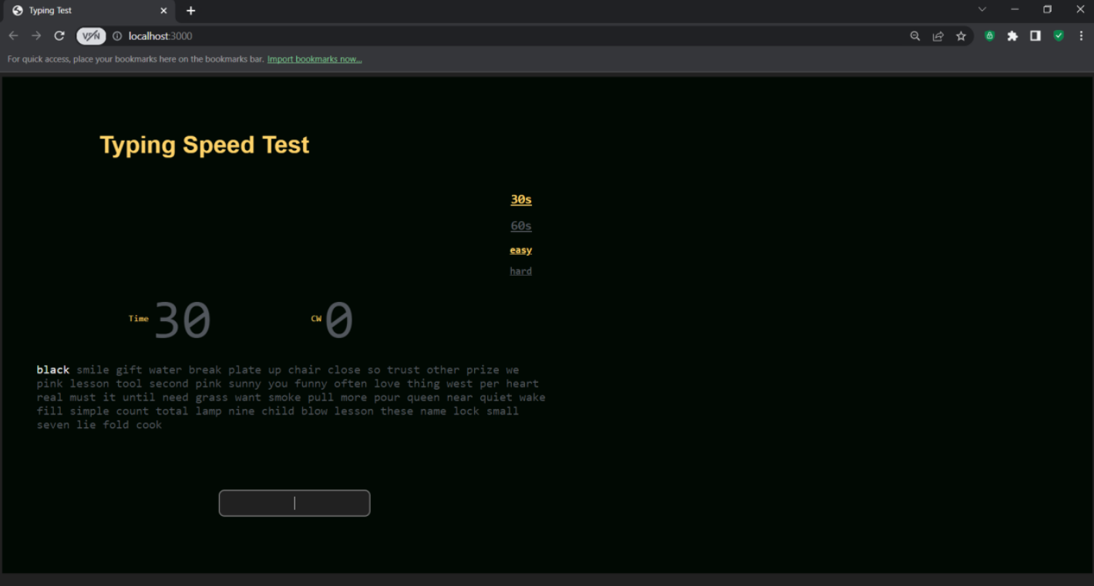
Website snapshots

Slide 6
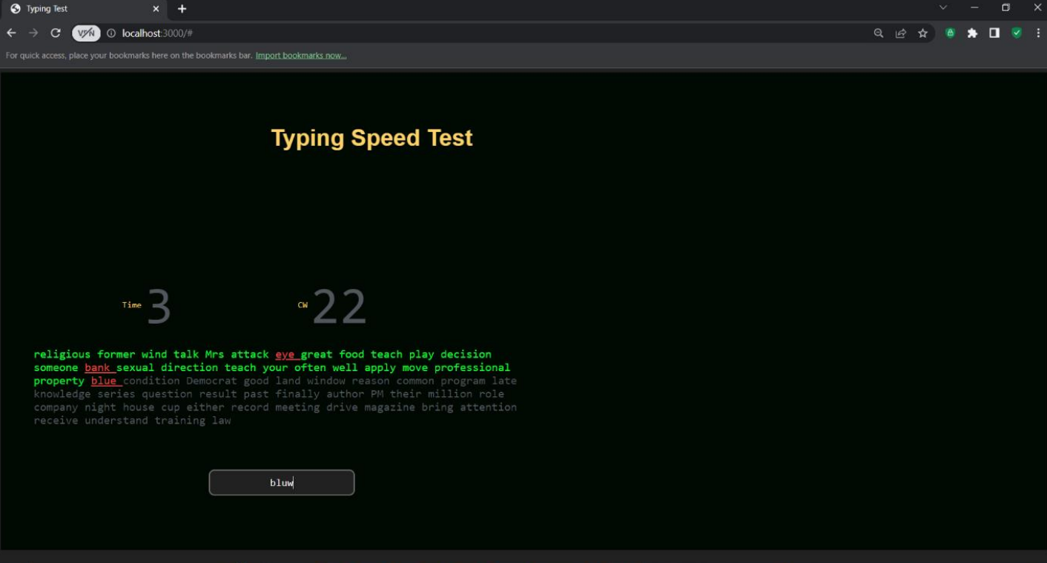

Slide 7

GITHUB LINK
https://github.com/shivamnath2001/NODEJS-PROJECT.git

Slide 8

THANK YOU

